Slide 1
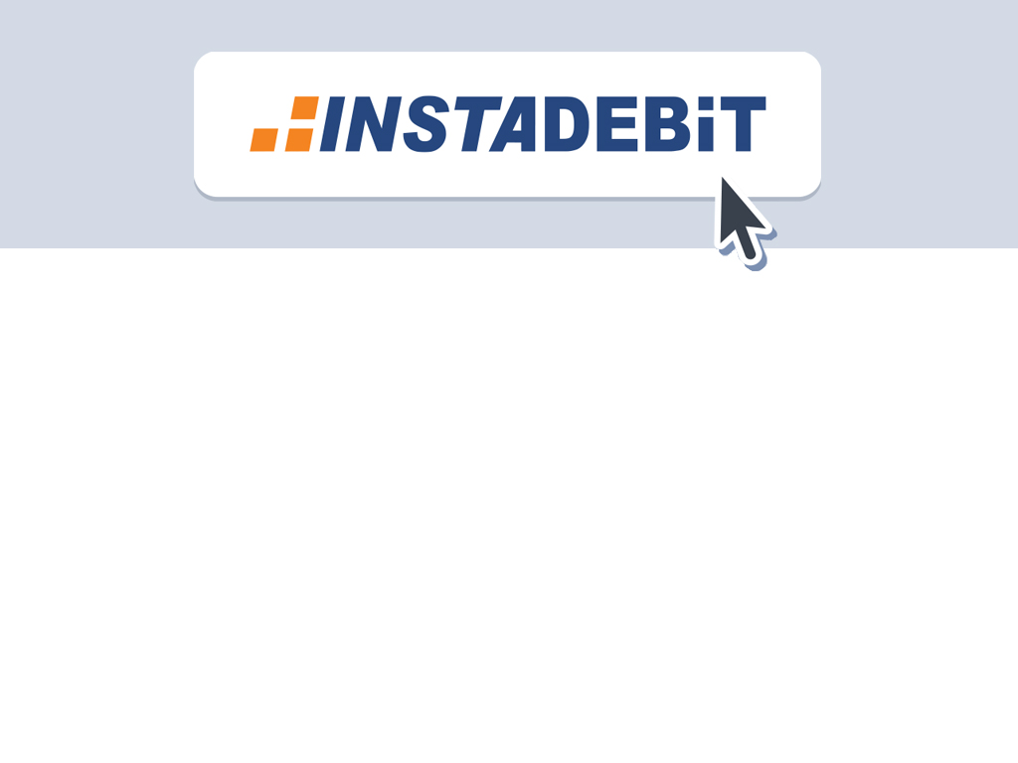
Transaction Flows
Deposits & Withdrawals
March 2017

Slide 2
Overview
New Customer Sign Up & First Transaction
Returning Customer
    Bank Transaction
    Balance Transaction
Withdrawal Process

Slide 3
New Customer Sign Up &
First Transaction

Slide 4
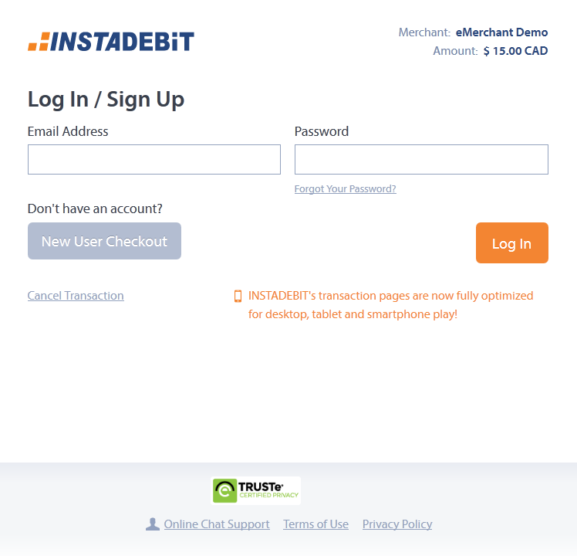
Select ‘New User Checkout’
A new user to INSTADEBIT will click on the ‘New User Checkout’ button.
This will enable them to instantly create a new INSTADEBIT account and complete their transaction.

Slide 5
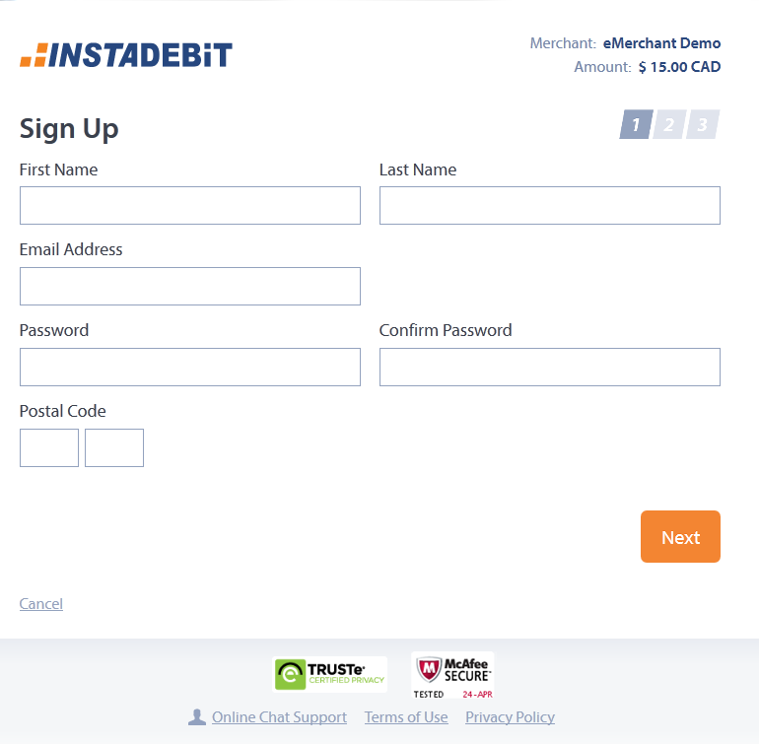
Step 2: Sign Up (1 of 2)
To create an INSTADEBIT account and complete their transaction, the customer must fill in the following fields:
First name
Last name
Email
Password
Confirm Password
Postal Code

Slide 6
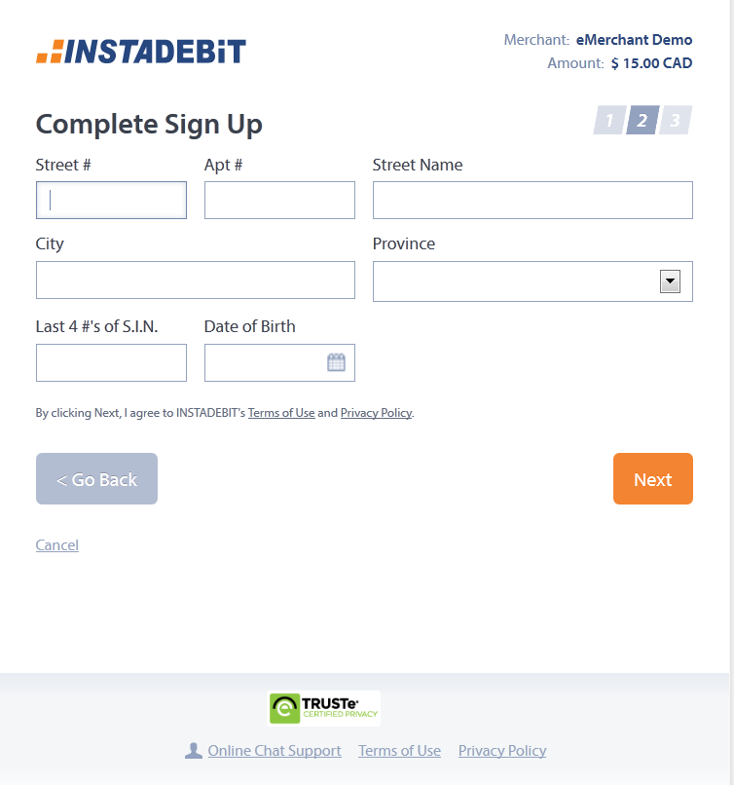
Step 2: Sign Up (2 of 2)
Entering the postal code on the previous page will result in the following fields being pre-populated on this address screen:
Street name
City
Province
All of the information on these two sign up screens are required in order to verify the customer’s ID.

Slide 7
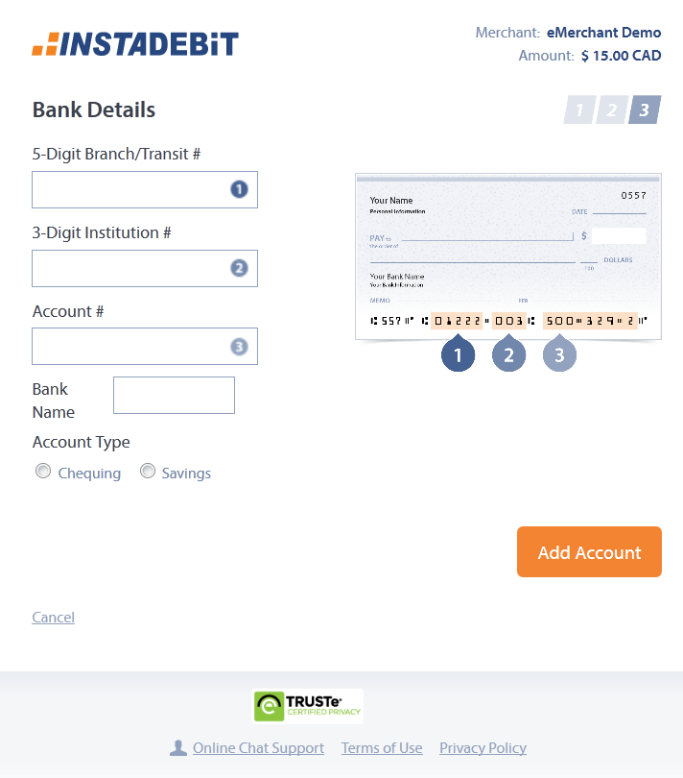
Step 3: Add bank details
Upon successful verification of the customer’s ID, they must enter their bank account details.
This information is only entered once and is retained in their profile for future transactions.

Slide 8
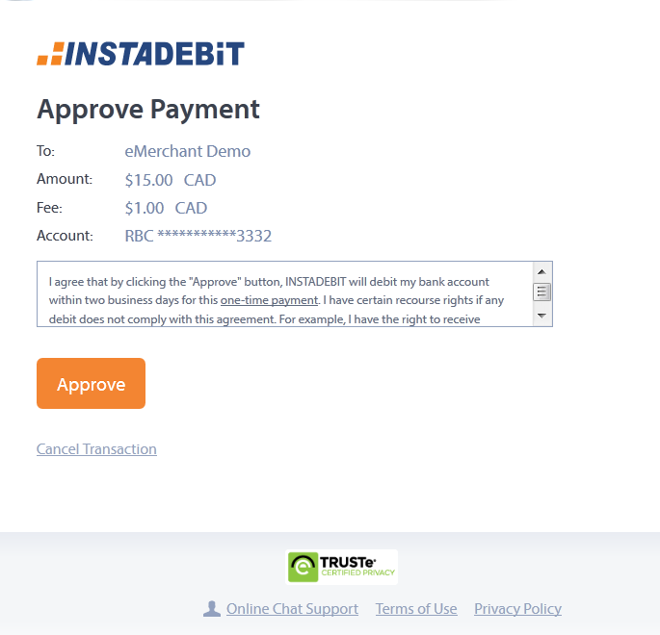
Step 4: Approve
The customer approves the payment.

Slide 9
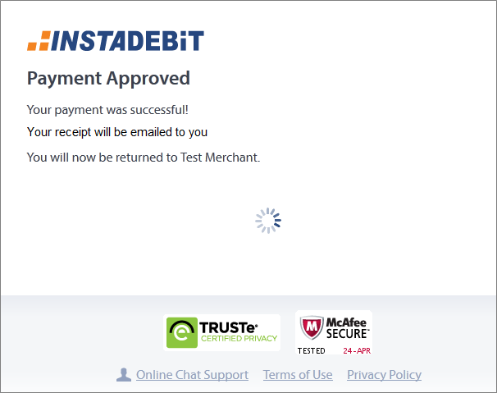
Payment Approved
Upon approval, customers are presented with this Payment Approved screen.
There is no action required by the customer on this page as they will automatically be taken back to their account page at the Merchant site after 3 seconds.

Slide 10
Returning Customer
Bank Transaction

Slide 11
Log In
If a customer already has an INSTADEBIT account, they simply log in with their email address and password.

Slide 12
Approve!
Then approve the payment.

Slide 13
Payment Approved
Upon approval, customers are presented with this Payment Approved screen.
There is no action required by the customer on this page as they will automatically be taken back to their account page at the Merchant site after 3 seconds.

Slide 14
Returning Customer
Balance Transaction

Slide 15
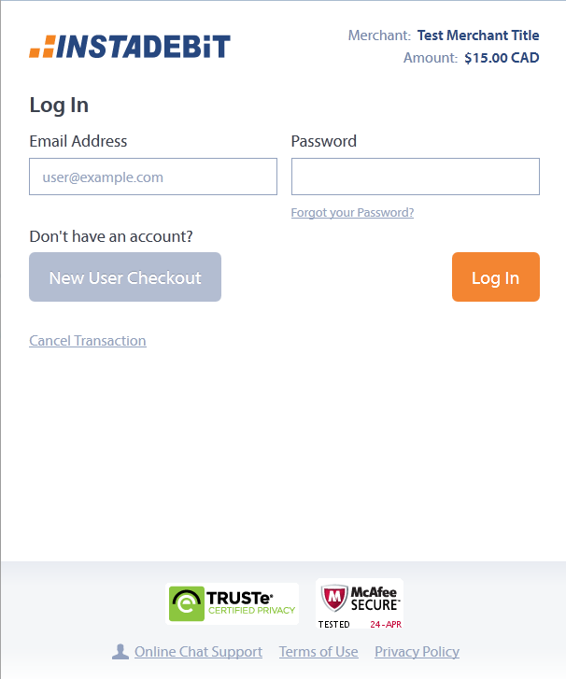
Log In
Balances are created in a user’s INSTADEBIT account upon receipt of a payout from a Merchant. These funds will automatically be used to make a payment so long as there is enough in the balance to cover the entire amount of the transaction.
Customers log in with their email address and password.

Slide 16
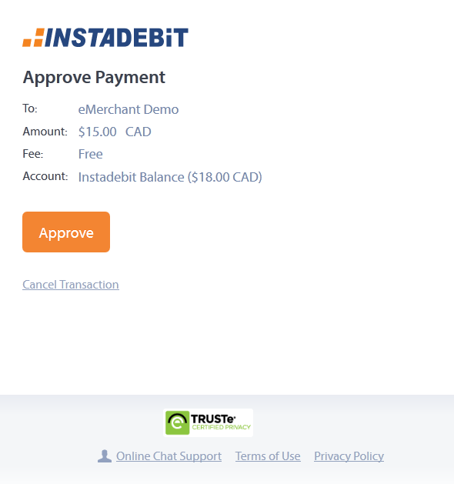
Approve!
Then approve the payment.
Note: no fee is charged for balance transactions and the “Account” field changes from the user’s bank account to “Instadebit Balance”.

Slide 17
Payment Approved
Upon approval, customers are presented with this Payment Approved screen.
There is no action required by the customer on this page as they will automatically be taken back to their account page at the Merchant site after 3 seconds.
The funds are taken from their INSTADEBIT account as opposed to their bank account and sent immediately to the Merchant for play.

Slide 18
Withdrawal Process

Slide 19
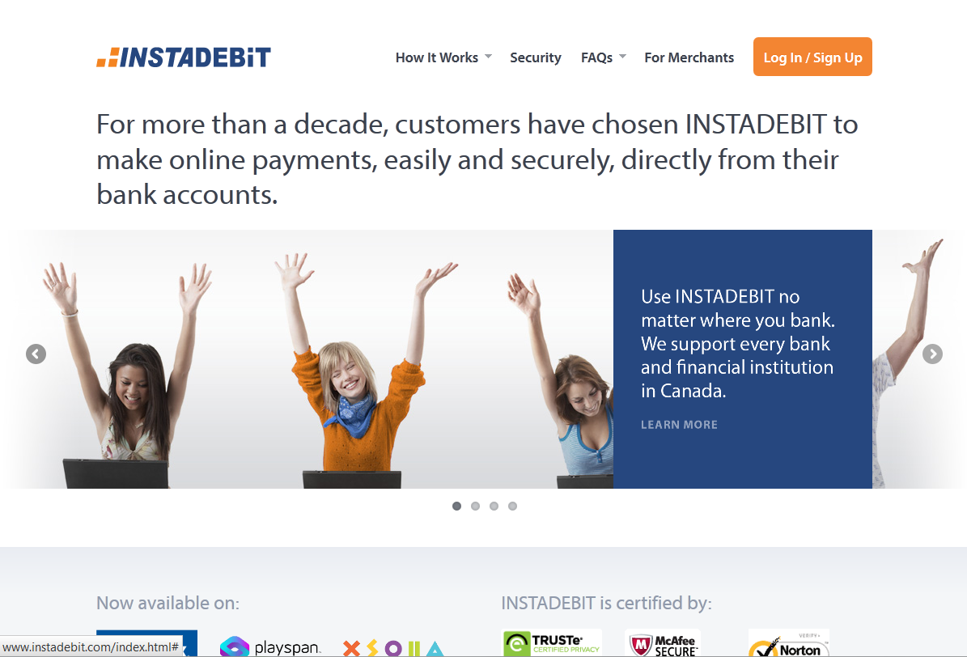
www.INSTADEBIT.com
If a customer receives a payout from a Merchant into their INSTADEBIT balance account, they can either use the funds to play at a Merchant’s site or ‘cash out’.
To cash out, the consumer must log in to their INSTADEBIT account at www.INSTADEBIT.com

Slide 20
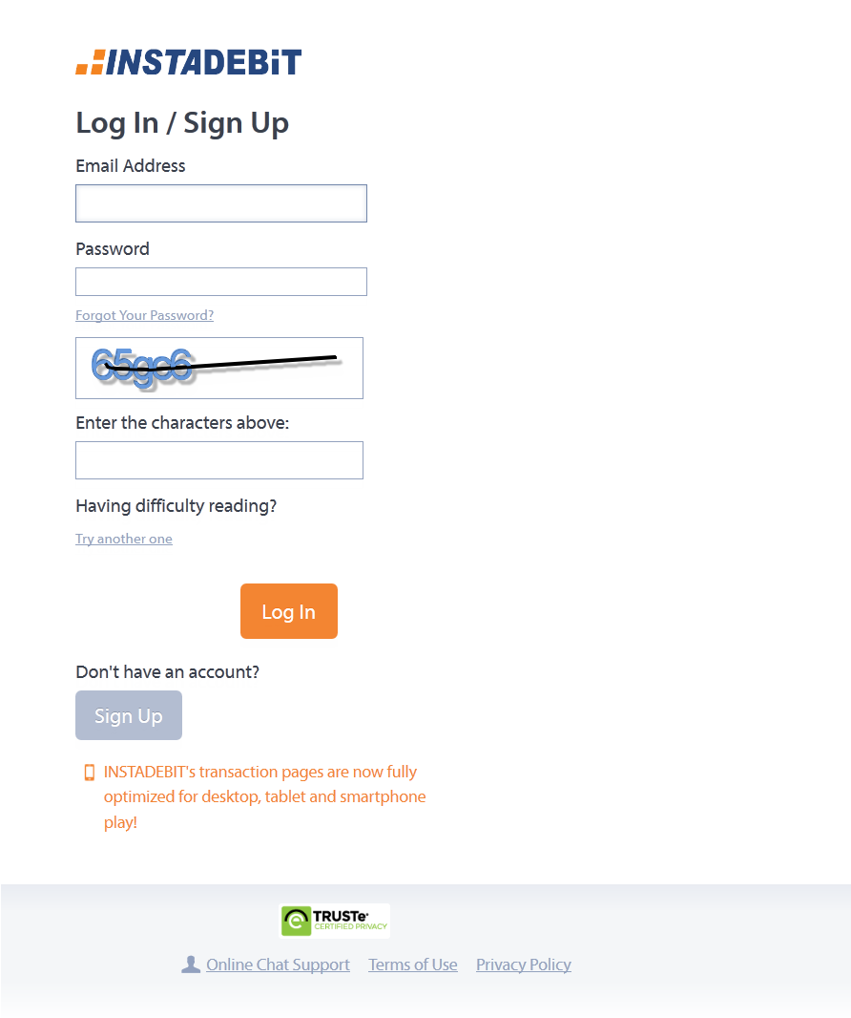
Log In
To access their account details, the customer must enter their email address, password, and correctly type in the CAPTCHA that is displayed on screen

Slide 21
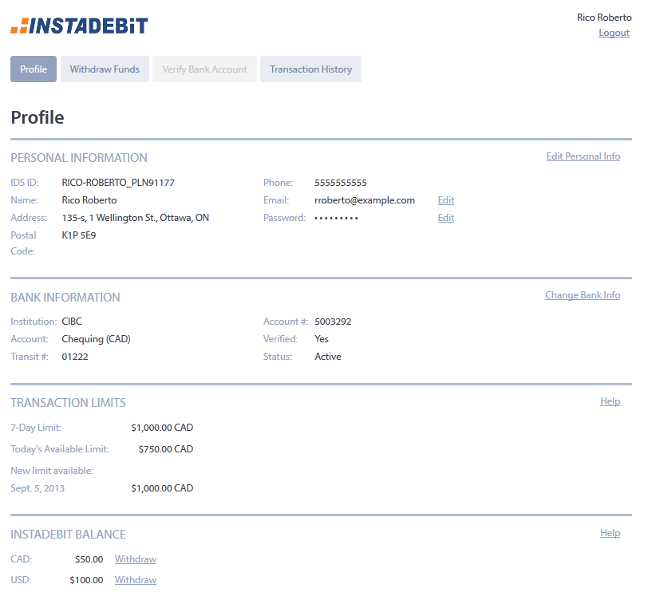
Withdraw Funds tab
Once in their profile, the customer clicks on either the Withdraw Funds tab at the top of the screen or the Withdraw hyperlink near their balance to have their payout sent to their bank account.

Slide 22
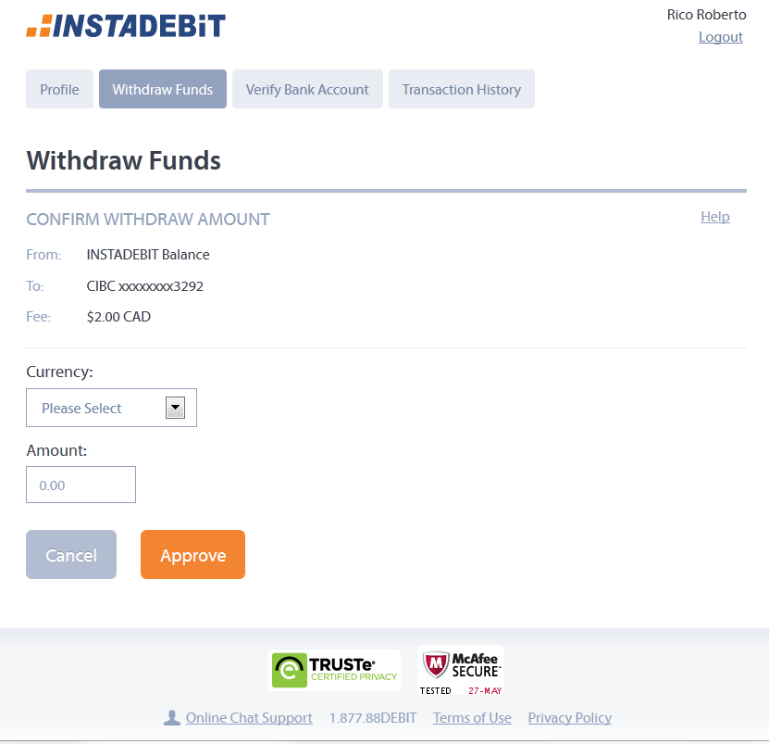
Enter amount to withdraw
The customer selects the currency of the INSTADEBIT balance that they wish to withdraw from and the amount they wish to withdraw.

Slide 23
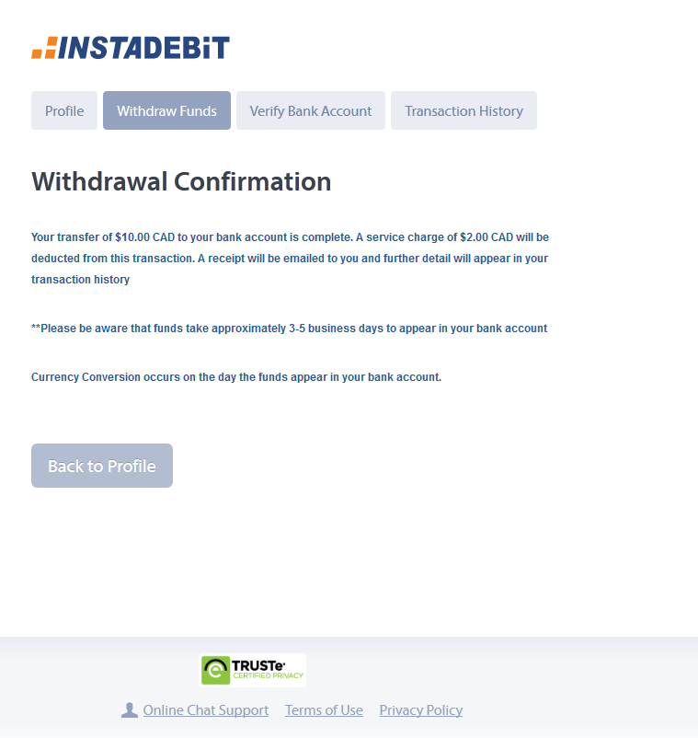
Withdrawal Confirmation
Upon clicking approve, the funds will be removed from their INSTADEBIT balance account and sent to their bank account within 3-5 days.

Slide 24
